Slide 1
IFITM3 Retrogenes with Intact ORF: Are They Functional?
Kazi Rahman
03/02/2018

Slide 2
IFITMs : Genomic and Syntenic Context
- Five different types: IFITM1, 2, 3, 5 and 10
All are in Chromosome 11
IFITM1, 2, and 3 are interferon-inducible and flanked by ATHL1 and BGalNT4 genes
ATHL1
B4GalNT4
BMC Genomics 2012 13:155

Slide 3
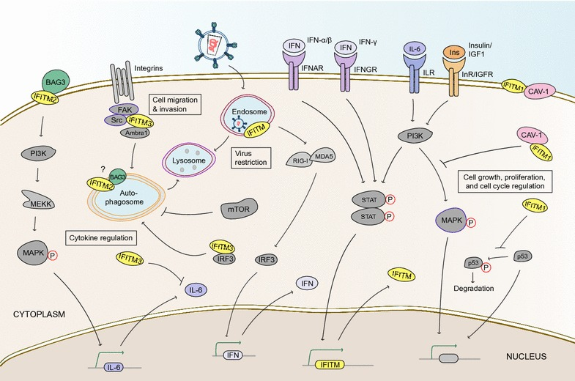
Role of IFITMs in Various Cellular Processes
Involved in
A. Virus Restriction (IFITM1, 2, 3)
B. Cell Adhesion
C. Anti-Proliferation
D. Tumor Suppression
E. Germ cell and embryo
development
Scarlett et al, Retrovirology 2017
Notes:
IFITM proteins are involved in various cellular processes with direct and indirect impacts on immunity. Virus restriction; In the event of successful virus invasion, nucleic acid sensors including RIG-I and MDA5 are triggered and IRF transcription factors are activated to induce the production of type-I interferons, which, in turn, initiate transcription of IFITM genes and other interferon-stimulated genes. IFITM proteins restrict the cytosolic access of virions undergoing endocytosis, possibly via inhibition of virus-cell fusion and destruction in an endolysosomal pathway. Cytokine regulation; IFITM3 is a negative regulator of the interferon response because it accelerates the turnover of IRF3 in autophagosomes. It also suppresses the production of IL-6, a pro-inflammatory cytokine which, itself, can also induce the expression of IFITM genes. IFITM2, in contrast, promotes the upregulation of IL-6 by acting as a cell surface receptor for secreted BAG3. As BAG3 is also a well-characterized chaperone for selective autophagy, it will be of interest to determine if IFITM2 also participates with BAG3 in autophagy-related processes. Cell migration and invasion; IFITM3 is a central component of a multi-protein interaction involving Src, FAK, and Ambra1, which is important for regulating cell adhesion and movement. IFITM3 assists in the subcellular trafficking of Src between focal adhesion points and autophagosomes. Cell growth, proliferation, and cell cycle regulation; Interferon signaling is known to negatively regulate cell division and growth via STAT signaling, with IFITM proteins serving as downstream effectors. IFITM1 interacts with caveolin-1 (CAV-1) to inhibit ERK/MAPK signaling, a pathway which stimulates cell proliferation when active. IFITM1 also stabilizes p53, a tumor suppressor with anti-proliferative functions

Slide 4
Recurrent Duplication of IFITM3 in Primates
Compton et al, EMBO Reports 2016

Slide 5
Origin of New Gene Copies through Gene Duplication
B. RNA-based duplication
Parental gene
Mature mRNA
Transcription and RNA splicing
B
AAAAAAAAAAA
A. DNA-based duplication
Reverse Transcription by LINE1, SINE etc
cDNA
AAAAAAAAAAA
Random Integration into the genome
Unequal crossing-over
AAAAAAAAAAA
Tandem Duplication
AAAAAAAAAAA
Parental gene
Duplicated gene
AAAAAAAAAAA
Intact ORF
Deleterious mutations
Deleterious
Mutations
Parental gene
Pseudogene

Slide 6
Parental IFITM3 (1) Chr. 11
Intact ORF (3)
Chr. 4, 8 and 12
ATHL1
B4GalNT4

Slide 7
Questions
Are those IFITM3 retrogenes with intact ORF functional?
A. Do they undergo transcription and translation?
B. What is their spatio-temporal expression pattern (i.e. specific
cells/tissues and timing of expression)?
C. Do they play redundant Roles of IFITM3 or gained
neofunctionalism?
Investigating the function of human IFITM3 retrogenes.

Slide 8
IFITM Duplicants in Human
Total 15 IFITM duplicants in Human
All are retrogenes –intronless/ PolyA-tailed
Intact ORF (2)
Deleterious
Mutations (13)

Slide 9
Evolutionary Conservation of IFITM8P2/12P1
IFITM8P2
(Chr. 8)
IFITMP12P1
(Chr. 12)

Slide 10
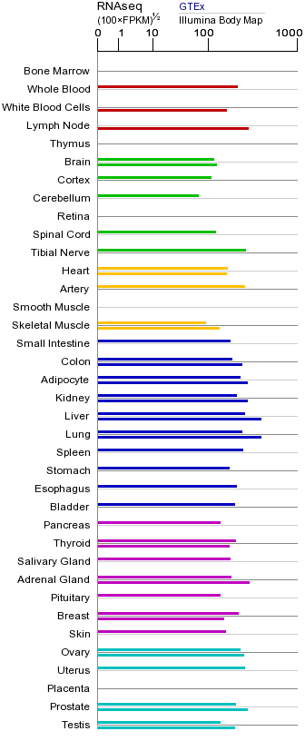
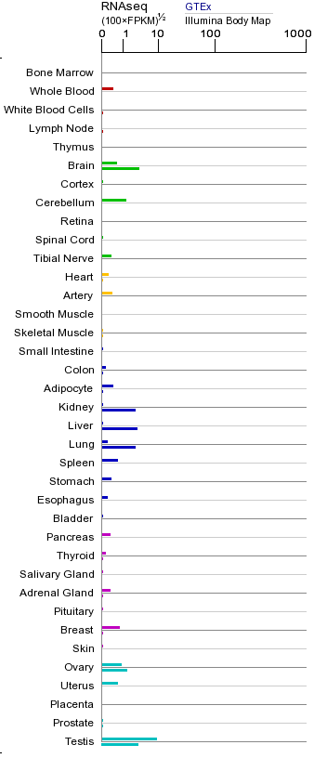
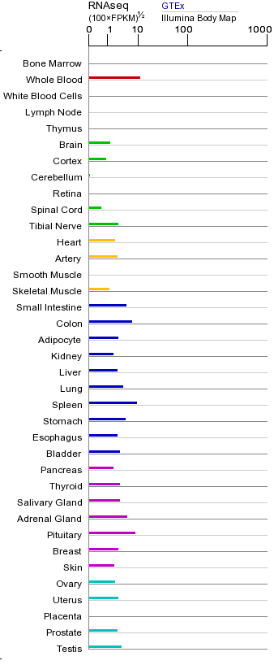
mRNA Expression In Normal Human Tissues From Genotype-Tissue Expression (GTEx) Consortium
IFITM3
IFITM8P2
IFITMP12P1

Slide 11
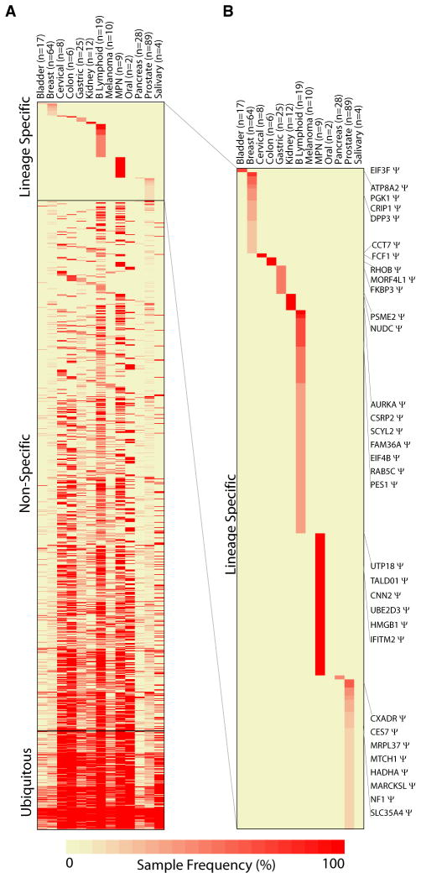
Transcriptomic Evidence of IFITM12P1 Expression
Tissue/Lineage-Specific Pseudogene Expression Profiles
Cell. 2012 Jun 22; 149(7): 1622–1634.
IFITMP12P1
Notes:
The butterfly effect in cancer: a single base mutation can remodel the cell.
We have compared the proteome, transcriptome, and metabolome of two cell lines: the human breast epithelial line MCF-10A and its mutant descendant MCF-10A-H1047R. These cell lines are derived from the same parental stock and differ by a single amino acid substitution (H1047R) caused by a single nucleotide change in one allele of the PIK3CA gene, which encodes the catalytic subunit p110α of PI3K (phosphatidylinositol 3-kinase). They are considered isogenic. The H1047R mutation of PIK3CA is one of the most frequently encountered somatic cancer-specific mutations. In MCF-10A, this mutation induces an extensive cellular reorganization that far exceeds the known signaling activities of PI3K. The changes are highly diverse, with examples in structural protein levels, the DNA repair machinery, and sterol synthesis. Gene set enrichment analysis reveals a highly significant concordance of the genes differentially expressed in MCF-10A-H1047R cells and the established protein and RNA signatures of basal breast cancer. No such concordance was found with the specific gene signatures of other histological types of breast cancer. Our data document the power of a single base mutation, inducing an extensive remodeling of the cell toward the phenotype of a specific cancer.

Slide 12
Proteomics Evidence of IFITM12P1 Expression
IFITM12P1
IFITM12P2
Unique peptide
IFITM12P3
J. Proteomic Research: 2016 Mar 4;15(3):945-55: Myoblastic cell lines
Mol. Cell Proteomics: 2016 Mar;15(3):1072-82: Pancreatic carcinoma
Scientific Data volume2: Article number: 150022 : Colon cancer
Mol. Cell Proteomics: 2012 Mar;11(3) :deep proteomics –in Jurkat cells

Slide 13
Potential Adoption of Regulatory Sequences in IFITM12P1
IFITM3: NO TATA box
Int +1 (-133-139)
GAS (-105-114)
ISRE (-72-78)
IFITM3
(Chr. 11)
ATG
IFITM12P1: NO TATA box
ISRE: Interferon-stimulated response element (for IFN-alfa/beta)
GAS: Interferon-Gamma Activated Sequence
Inr+1 : Transcription Start Site (TSS)
Int +1 (-268-274)
GAS (-96-104)
Enhancer (48 TFs)
ISRE (-72-78)
ATG
IMITM12P1
(Chr 12)
LINE1/L1MC4
AAAAAAA
-1.5 Kb

Slide 14
Aim-1: Is endogenous IFITM12P1 undergoes transcription and if these exapted regulatory sequences are active?
Experiments:
A. Determine the level of IFITM12P1 RNA expression in different cells/tissues by RT-PCR
B. Endogenous Tagging of IFITM12P1 by CRISPR/Cas9
C. 5’-RACE (Rapid amplification of cDNA ends) analysis to check the TSS.

Slide 15
Aim-2: Investigating the role of IFITM12P1

Slide 16
Ectopically Expressed IFITM12P1 Shows Instability
Stable 293-T cells expressing
FLAG-IFITM12P1/IFITM3
IFITM3
IFITM12P1

Slide 17
Why IFIM12P1 shows Instability in comparison to IFITM3?
IFITM12P1 Might Degrade by Lysosome
Bafilomycin-Treated
MG132-treated
Untreated

Slide 18
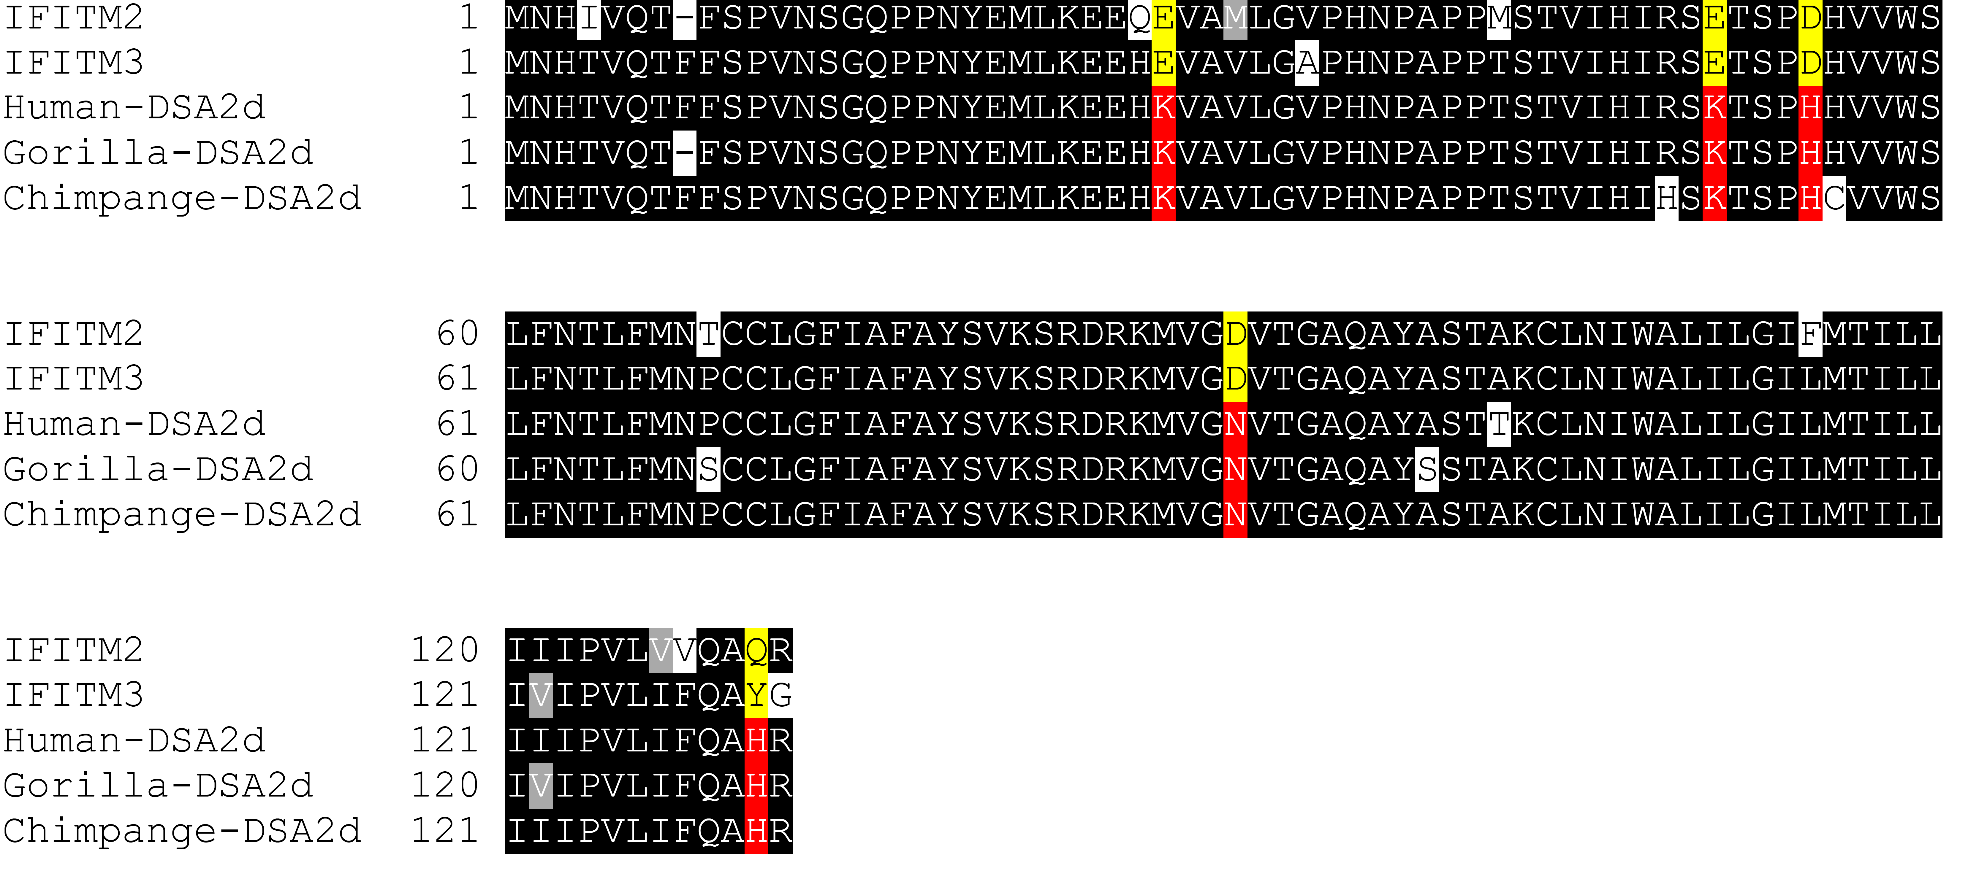
Sequence Variations among IFITM12P1 and IFITM2/IFITM3
E27K
E50K
D54H
IFITM12P1
IFITM12P1
IFITM12P1
D91N
IFITM12P1
IFITM12P1
IFITM12P1
Which amino acids are responsible for IFITM12P1
instability?
IFITM12P1
IFITM12P1
IFITM12P1

Slide 19
Aim-2a: Which amino acid(s) render IFITM12P1 unstable?
Experiments:
A. SDM of each modified a.a. and testing their impact on expression pattern.
B. Determine if that specific mutation is a characteristic pattern of other retrogenes to
find for a universal code of retrogene instability

Slide 20
Aim-2b: What is the endogenous role of IFITM12P1 in cellular immunity against virus and/or in other cellular processes?
Experiments:
Redundant function of IFITMs?
Knocking out the IFITM12P1 by CRISPR/Cas9 in different cell types and test for mutants
against virus challenge.
B. Inhibiting the expression of IFITMs by anti-sense RNA?
Co-expression of IFITM3 and IFITM12P1 and check the impact on IFITM3 expression
Enhancing the expression of IFITMs by binding with the IFIMT3 miRNAs?
Expression of IFITM12P1 3’-UTR in Hela cells and explore the expression level of IFITM3

Slide 21
Knocking-out of IFITMP121 by CRISPR attempt
Experimental progress:
-Made stable 293T cells and Hela cells expressing Cas9 protein.
gRNA positions
ATG
IFITM12P1
(Chr 12)
LINE1/L1MC4
AAAAAAA
-1.5 Kb

Slide 22
Thanks

